Slide 1


SHARED INTEREST SOCIETY
www.shared-interest.com

Slide 2

www.shared-interest.com

Slide 3
Founded in 1990 in the north-east of England
An ethical lender, which is a community-benefit society and acts co-operatively with investment from over 10,000 UK-based members and Share Capital of £52m
International organisation with teams in the UK, Kenya, Ghana, Peru and Costa Rica
Strong supporter of fair trade and a World Fair Trade Organisation (WFTO) member
Member of The Council on Smallholder Agricultural Finance (CSAF)
Recognised with a Queen’s Award in Sustainable Development three times
BACKGROUND
www.shared-interest.com

Slide 4
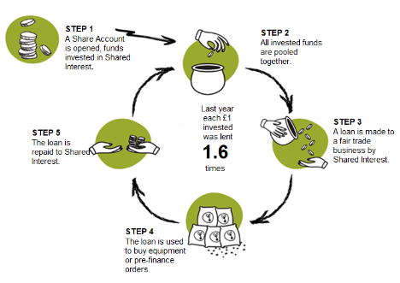
HOW IT WORKS
www.shared-interest.com

Slide 5
OUR IMPACT
www.shared-interest.com

Slide 6
INKA MOSS
www.shared-interest.com

Slide 7
INKA MOSS
www.shared-interest.com

Slide 8
If you are a UK resident over the age of 16 and you want to do amazing things with your money, then a Shared Interest Share Account will appeal to you.
You can start changing lives from £100 and up to £100,000.
These vital funds are used to provide finance to fair trade farmers and craftspeople in 45 countries around the world. It is simple: your ethical investment will change lives.
The interest rate offered to members from 1st October 2021 is 0.1%.
HOW IT WORKS
www.shared-interest.com

Slide 9

We believe that five of the SDGs are particularly embedded in Shared Interest’s mission and values:
1. No Poverty
5. Gender Equality
8. Decent work and Economic Growth
12. Responsible Production and Consumption
17. Partnership for the Goals
www.shared-interest.com

Slide 10
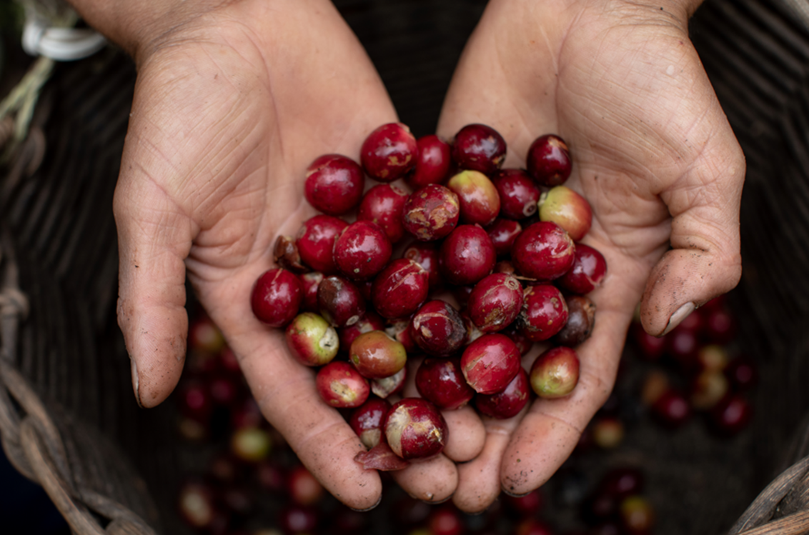
THANK YOU
www.shared-interest.com

